Slide 1
How The Linux Foundation Standards For License Compliance And Security Will Fix Your Supply Chain

Slide 2

Our Mental Model Of The Supply Chain

Slide 3

The Actual Supply Chain

Slide 4
67.4%
of managers monitor their supply chain with Excel spreadsheets
https://www.zippia.com/advice/supply-chain-statistics/

Slide 5
94%
of companies do not have full visibility of their supply chain
https://www.zippia.com/advice/supply-chain-statistics/

Slide 6
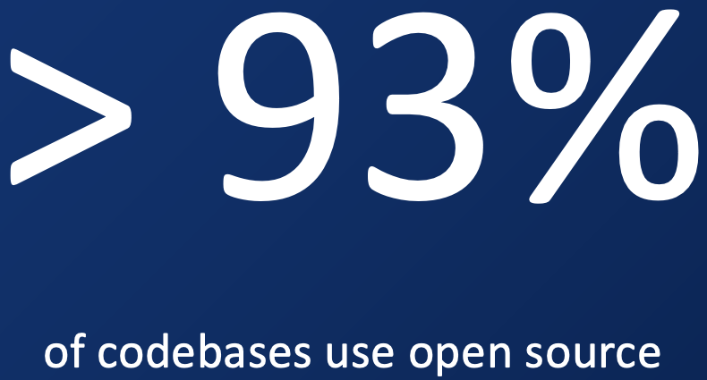
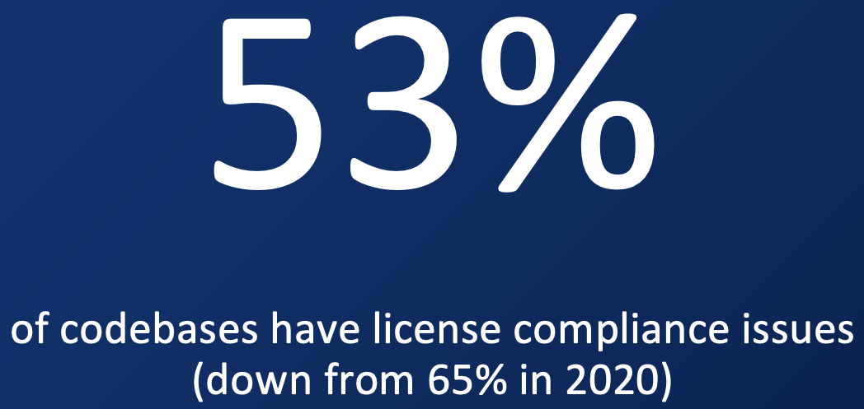
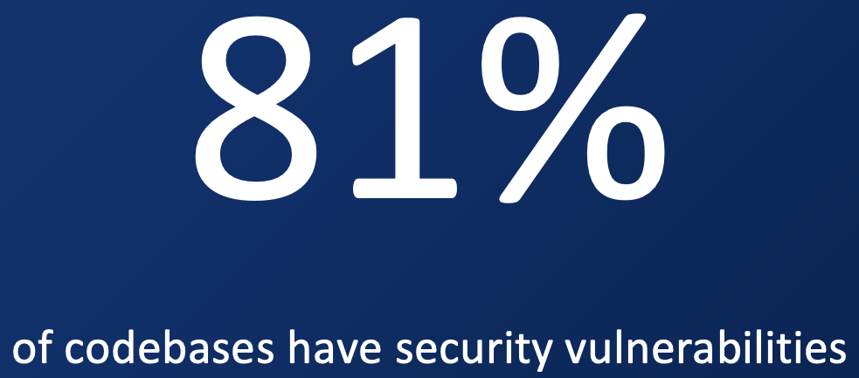
https://www.synopsys.com/blogs/software-security/open-source-trends-ossra-report/

Slide 7
> 93%
of codebases using open source
https://www.synopsys.com/blogs/software-security/open-source-trends-ossra-report/

Slide 8
81%
of codebases have security vulnerabilities
https://www.synopsys.com/blogs/software-security/open-source-trends-ossra-report/

Slide 9
53%
of codebases contain license compliance issues
https://www.synopsys.com/blogs/software-security/open-source-trends-ossra-report/

Slide 10



https://www.zippia.com/advice/supply-chain-statistics/

Slide 11
57%
of companies see supply chain management as a competitive edge
https://www.zippia.com/advice/supply-chain-statistics/

Slide 12
70%
of companies see supply chains as a driver for customer service
https://www.zippia.com/advice/supply-chain-statistics/

Slide 13
40%
savings available for industrial suppliers via optimization
https://www.zippia.com/advice/supply-chain-statistics/

Slide 14
Context: This Is Important To Business
Open Source License Compliance and Security Assurance is a key part of supply chain management.

Slide 15


We Got Together To Improve The Supply Chain

Slide 16
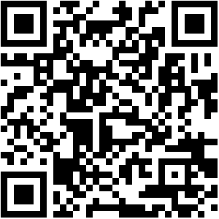
Broader Community
Main Work Groups:
Specification (Spring 2016~)
Education (Autumn 2020~)
Community Work Groups:
Tooling (Summer 2019~)
Export Control (Winter 2022~)
Public Policy (Winter 2022~)
Special Interest Groups:
Automotive (Summer 2019~)
Telecom (Spring 2021~)
Regional User Groups
Japan (Dec 2017~)
Korea (Jan 2019~)
India (Sept 2019~)
China (Sept 2019~)
Taiwan (Sept 2019~)
Germany (Jan 2020~)
UK (June 2020~)
USA (Dec 2020~)
Notes:
Here are some examples of our global work groups and when they started.

Slide 17
1,000+
Companies Working On A Better Supply Chain

Slide 18
Trust Built By Process Management
In Market Q4 2016~ (de facto) Q4 2020 (ISO/IEC) OpenChain ISO/IEC 5230:2020 The International Standard for open source license compliance.
In Market Q4 2022~ (de facto) Q3 2023 projected (ISO/IEC) ISO/IEC DIS 18974, OpenChain Security Assurance Specification The de facto standard for open source security assurance compliance.
High level process standards;
Simple, effective and suitable for companies of all sizes in all markets;
Openly developed by a vibrant user community and freely available to all.

Slide 19
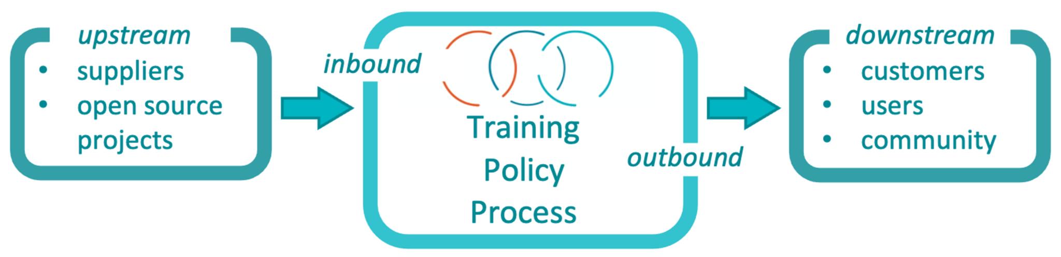
The Standards Work Company By Company
Result = A More Predictable Supply Chain
Notes:
The OpenChain standards define the big picture, showing the inflection points where a company should have processes, policies or training.

Slide 20
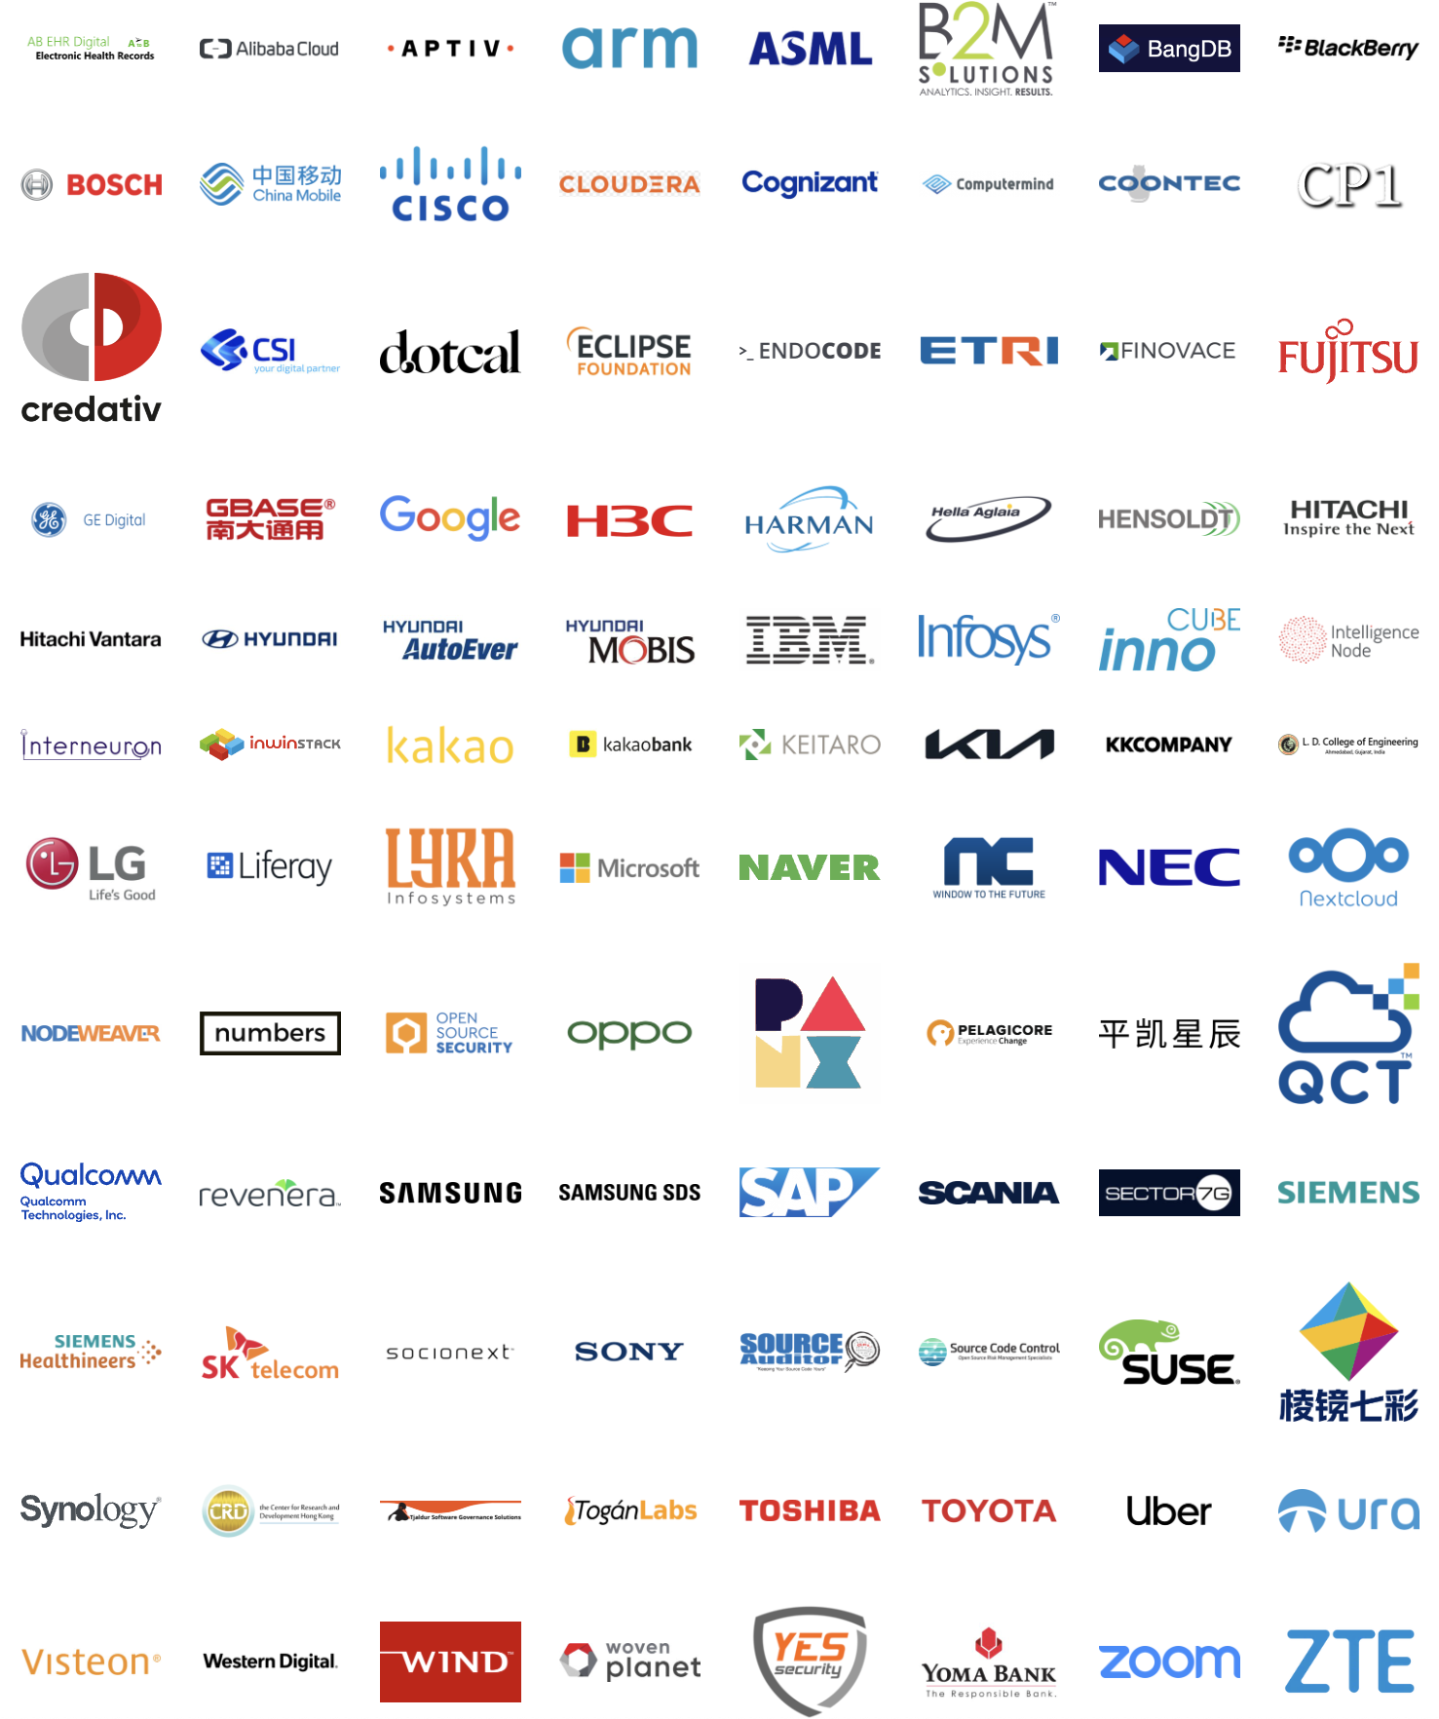
Example Adoption Of OpenChain ISO/IEC 5230:2020
Notes:
The total market adoption is far larger. For example, a PwC-sponsored survey by Bitkom showed 20% of German companies with 2,000 or more employees were already using ISO 5230

Slide 21
20%
of German companies with over 2,000 employees already use OpenChain ISO/IEC 5230
https://www.pwc.de/en/digitale-transformation/pwc-bitkom-study-open-source-monitor-2021.pdf

Slide 22
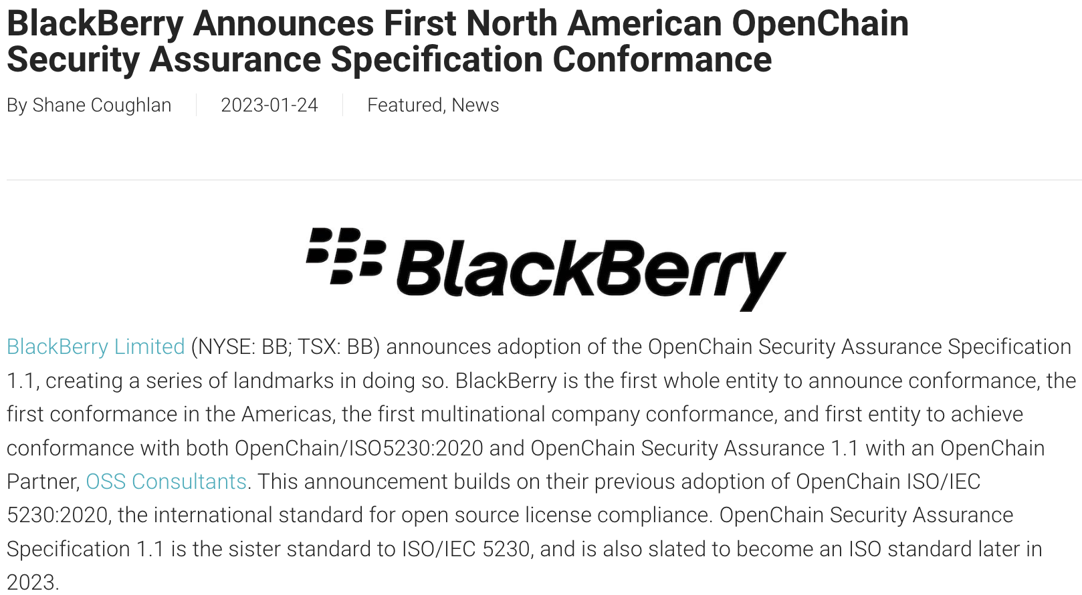
Security Assurance Specification Traction

Slide 23
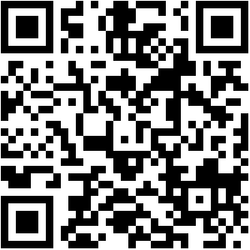
Freedom Of Choice In Using Our Standards
Self-Certification
Independent Assessment
Third-Party Certification
Notes:
When it comes to meeting the OpenChain industry standard for open source compliance, we are fostering a diverse series of options for our diverse range of stakeholders, from self-certification to independent compliance assessments to third party certification. For example, a company can use our free online questionnaire to self-certify without cost. Or they can hire a third party certifier to have outside confirmation of processes. It is up to the company and the market.

Slide 24
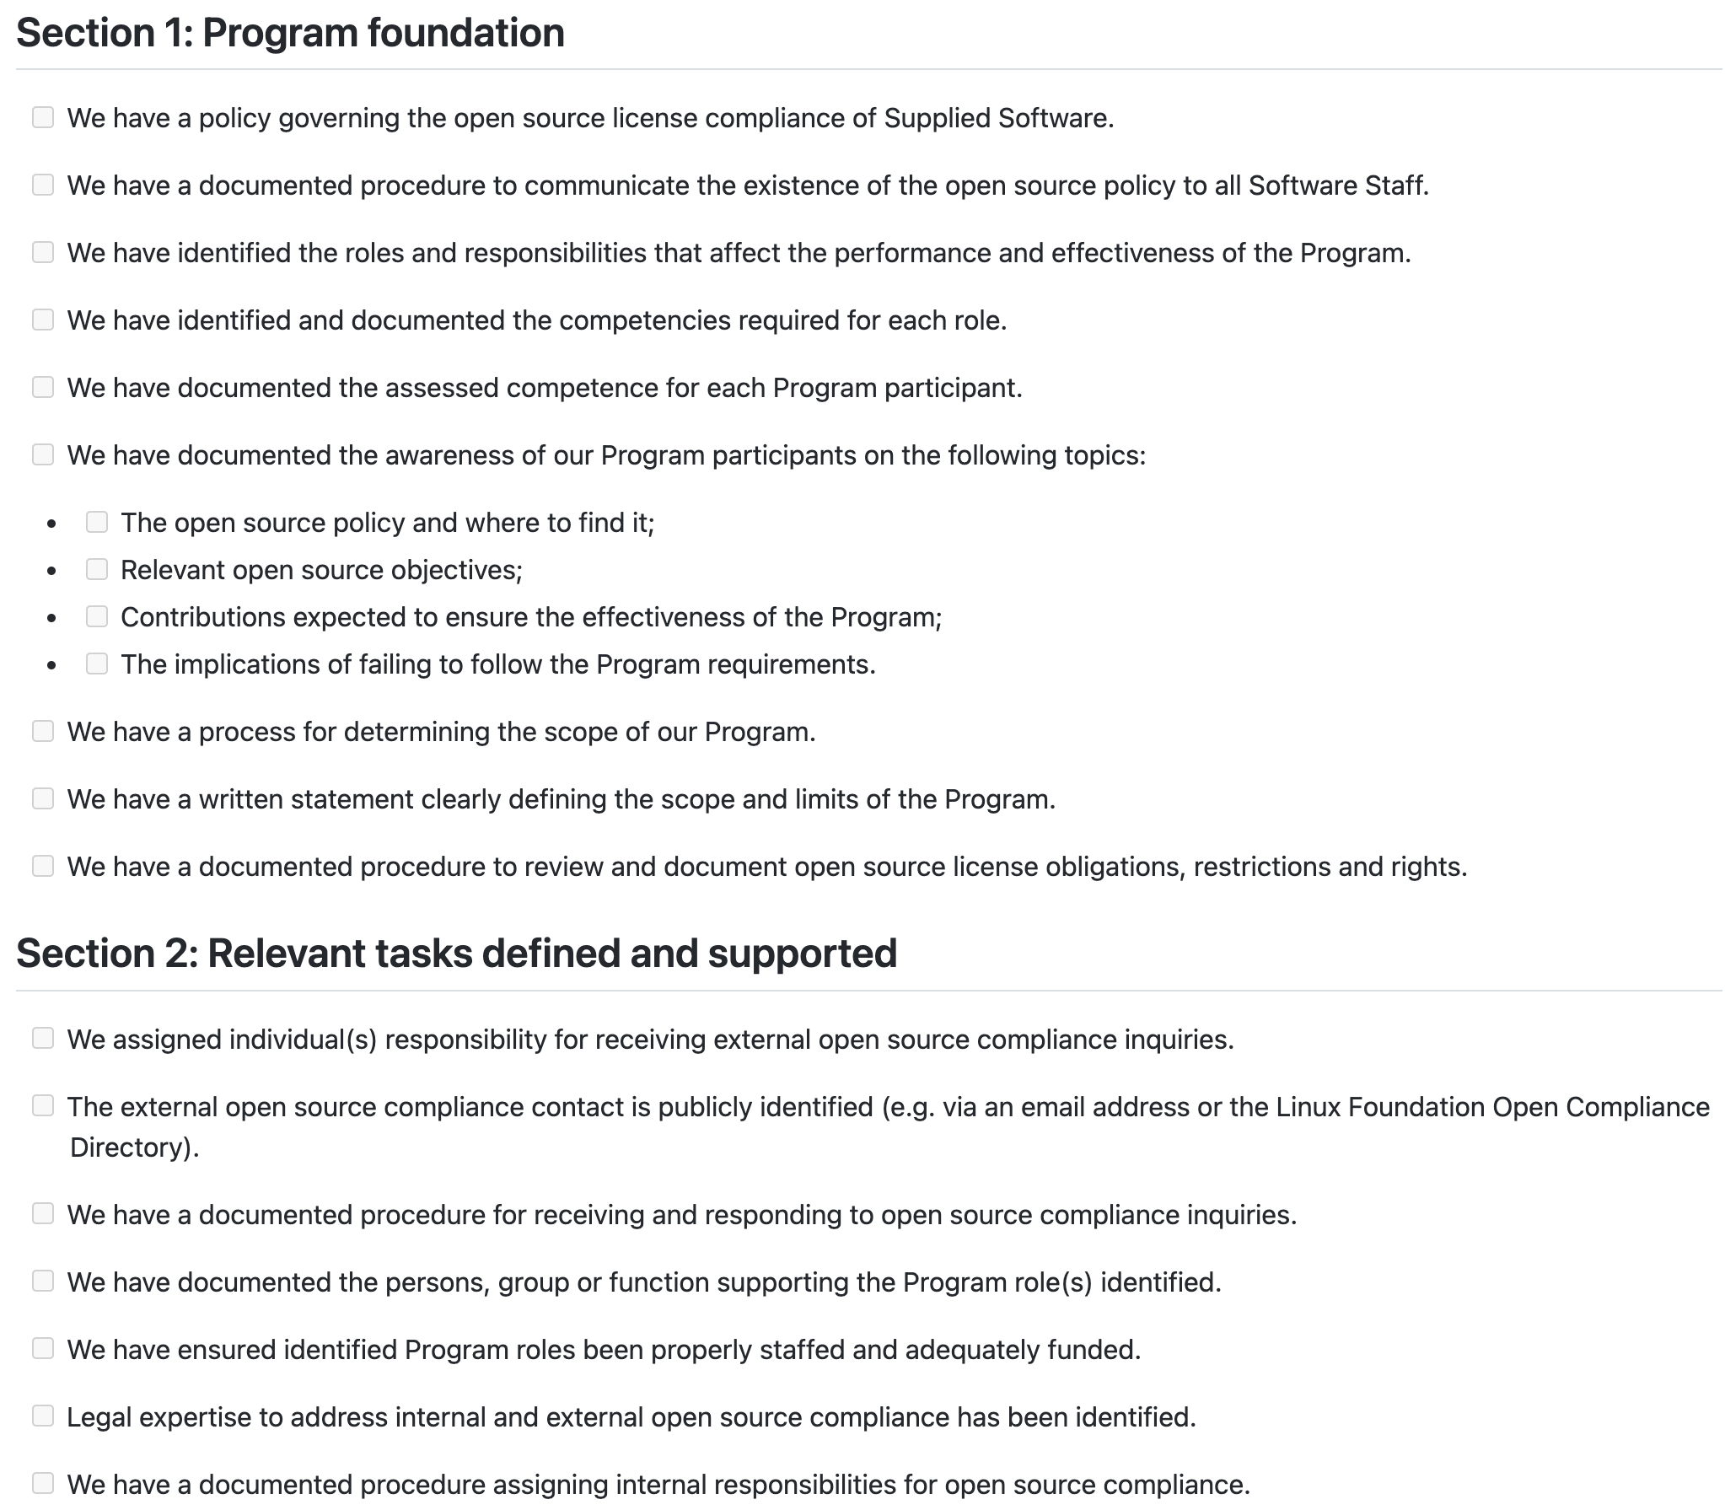
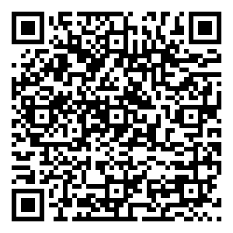
Free Self-Certification Material
Notes:
We provide a wide range of reference materials and translations.

Slide 25
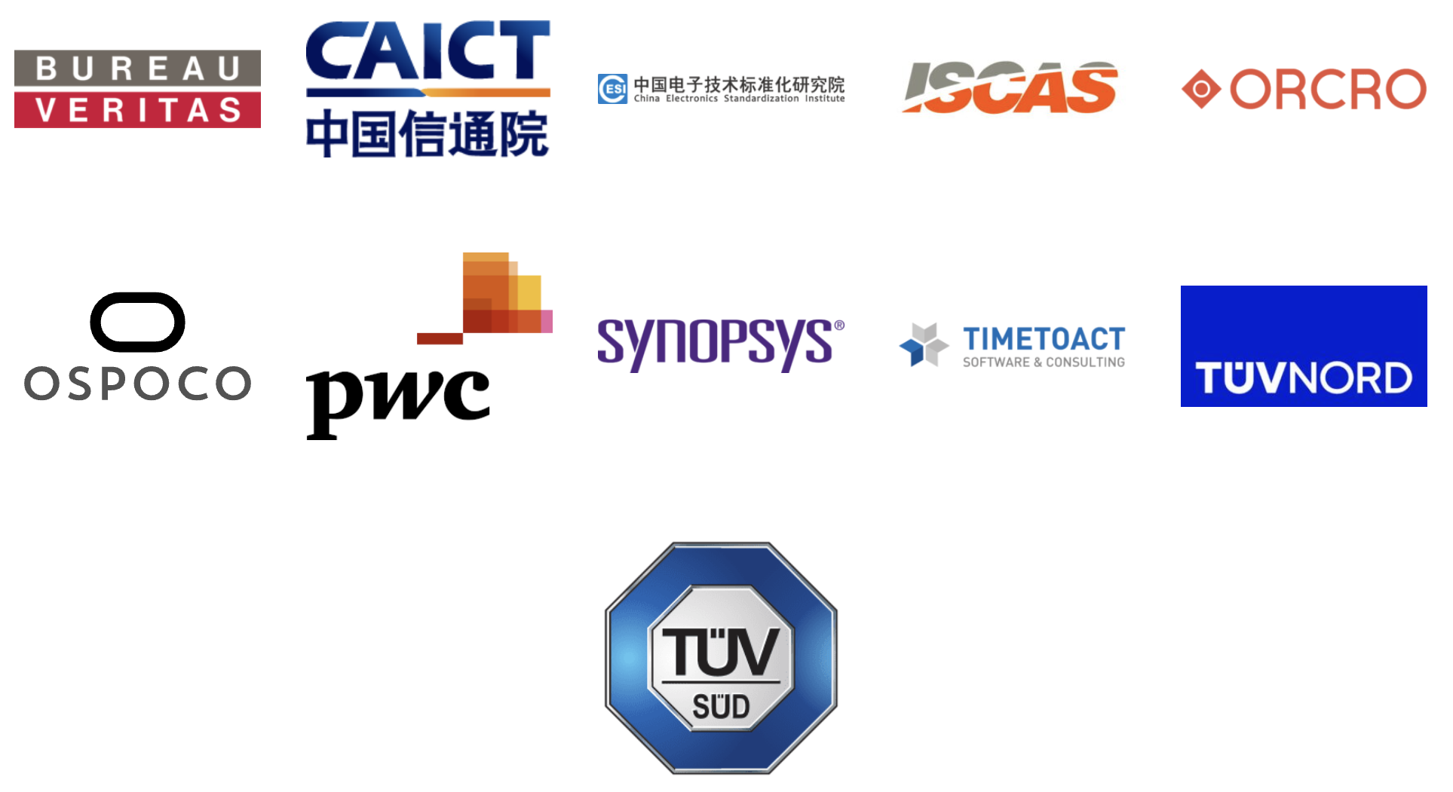
11 Third-Party Certifiers Providing Global Coverage
Notes:
We have a growing number of global third party certifiers available.

Slide 26
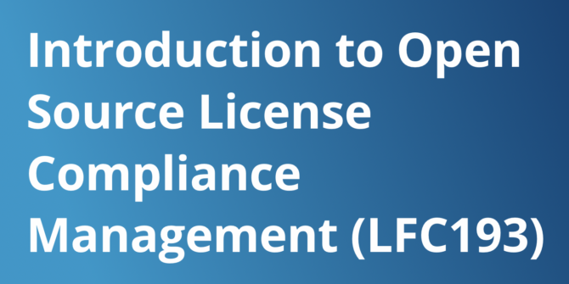
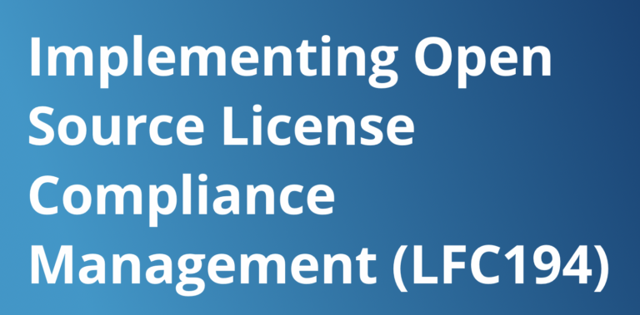
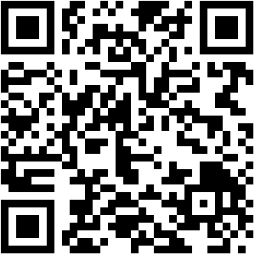
Free Online Training Courses
LFC193 - 1209 total enrollments (398 digital badges issued) 4.65 out of 5 rating by users
LFC194 - 579 total enrollments (138 digital badges issued) 4.55 out of 5 rating by users
Notes:
We work with LF Training to help make education easier around open source process management.

Slide 27
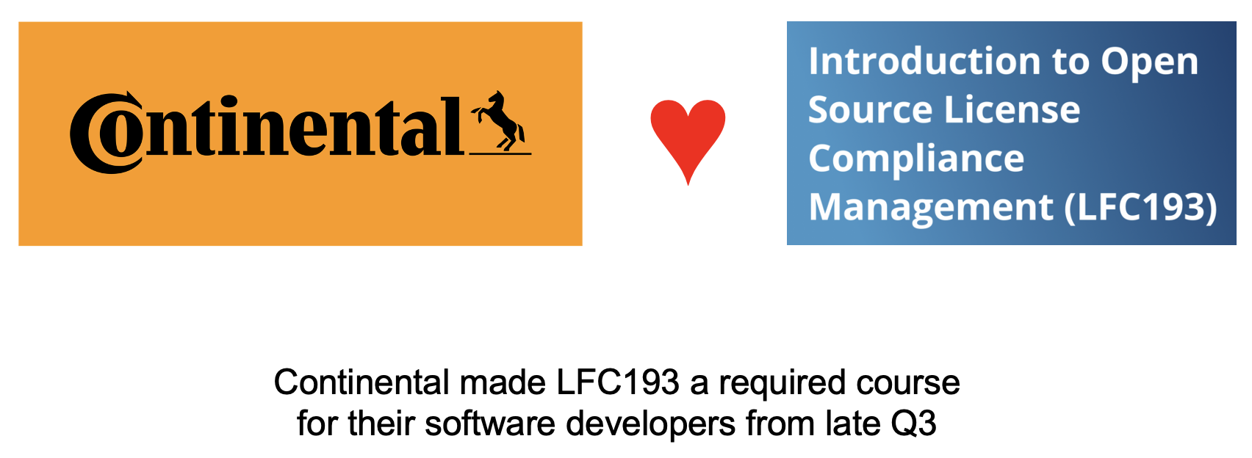
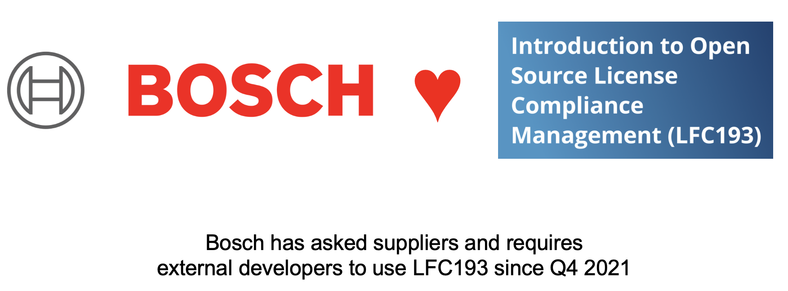

Example Of Market Use
Notes:
These resources make a real difference to companies

Slide 28
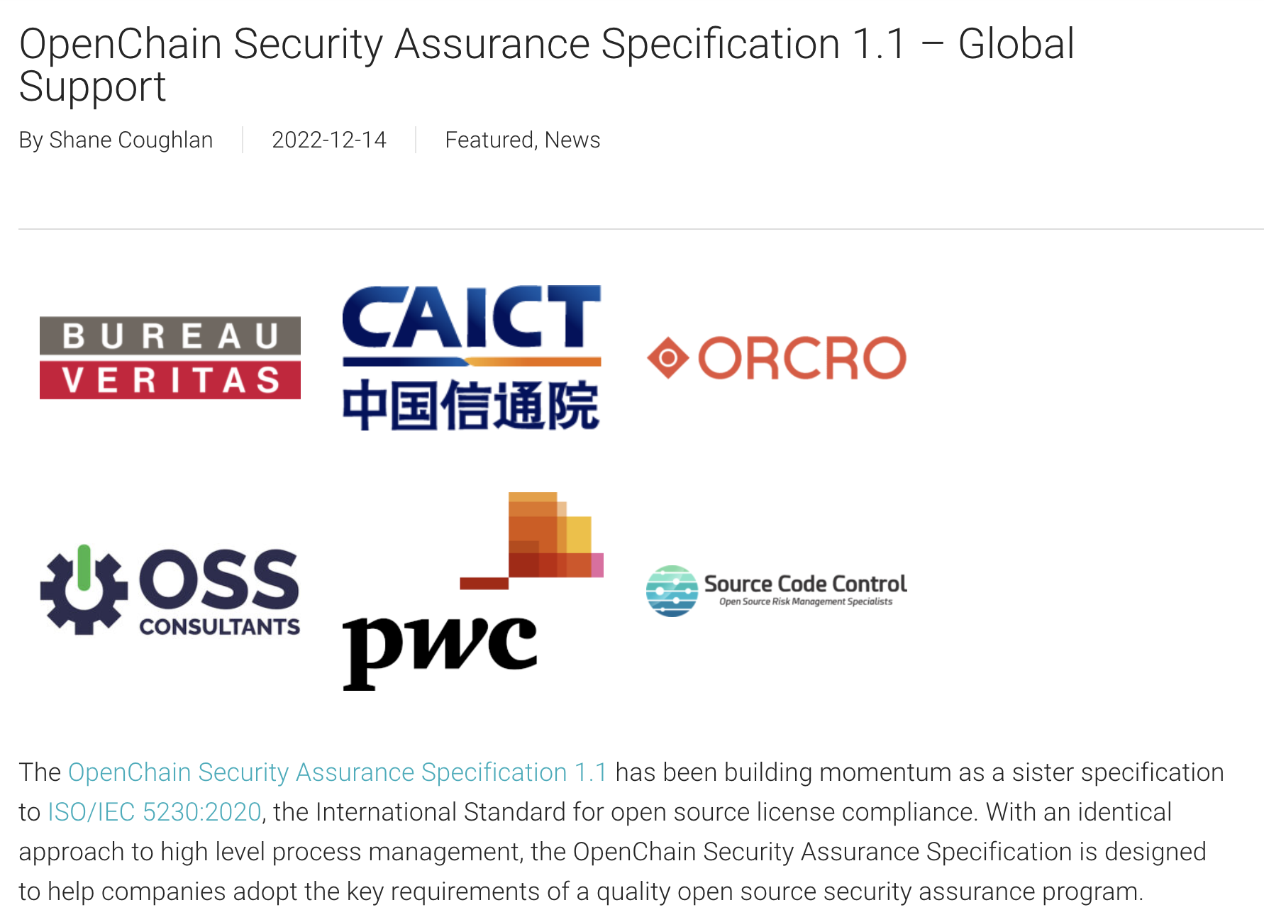
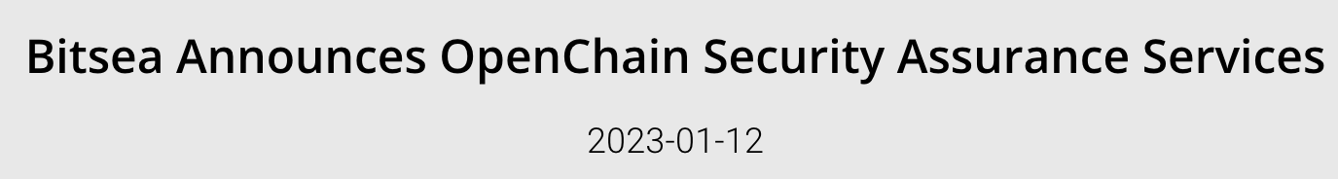

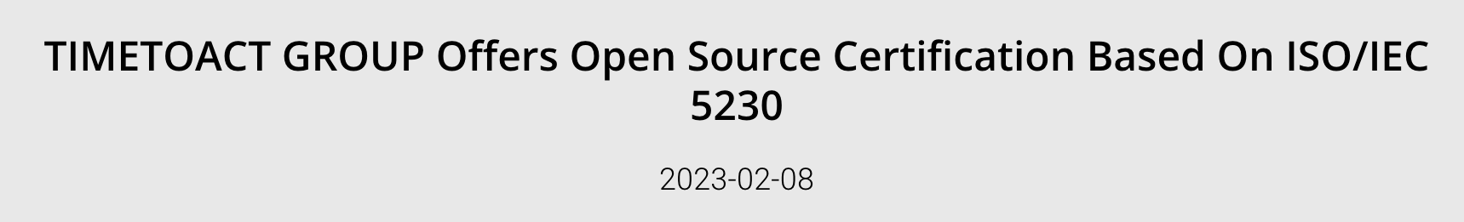
Continually Expanding Support Coverage

Slide 29
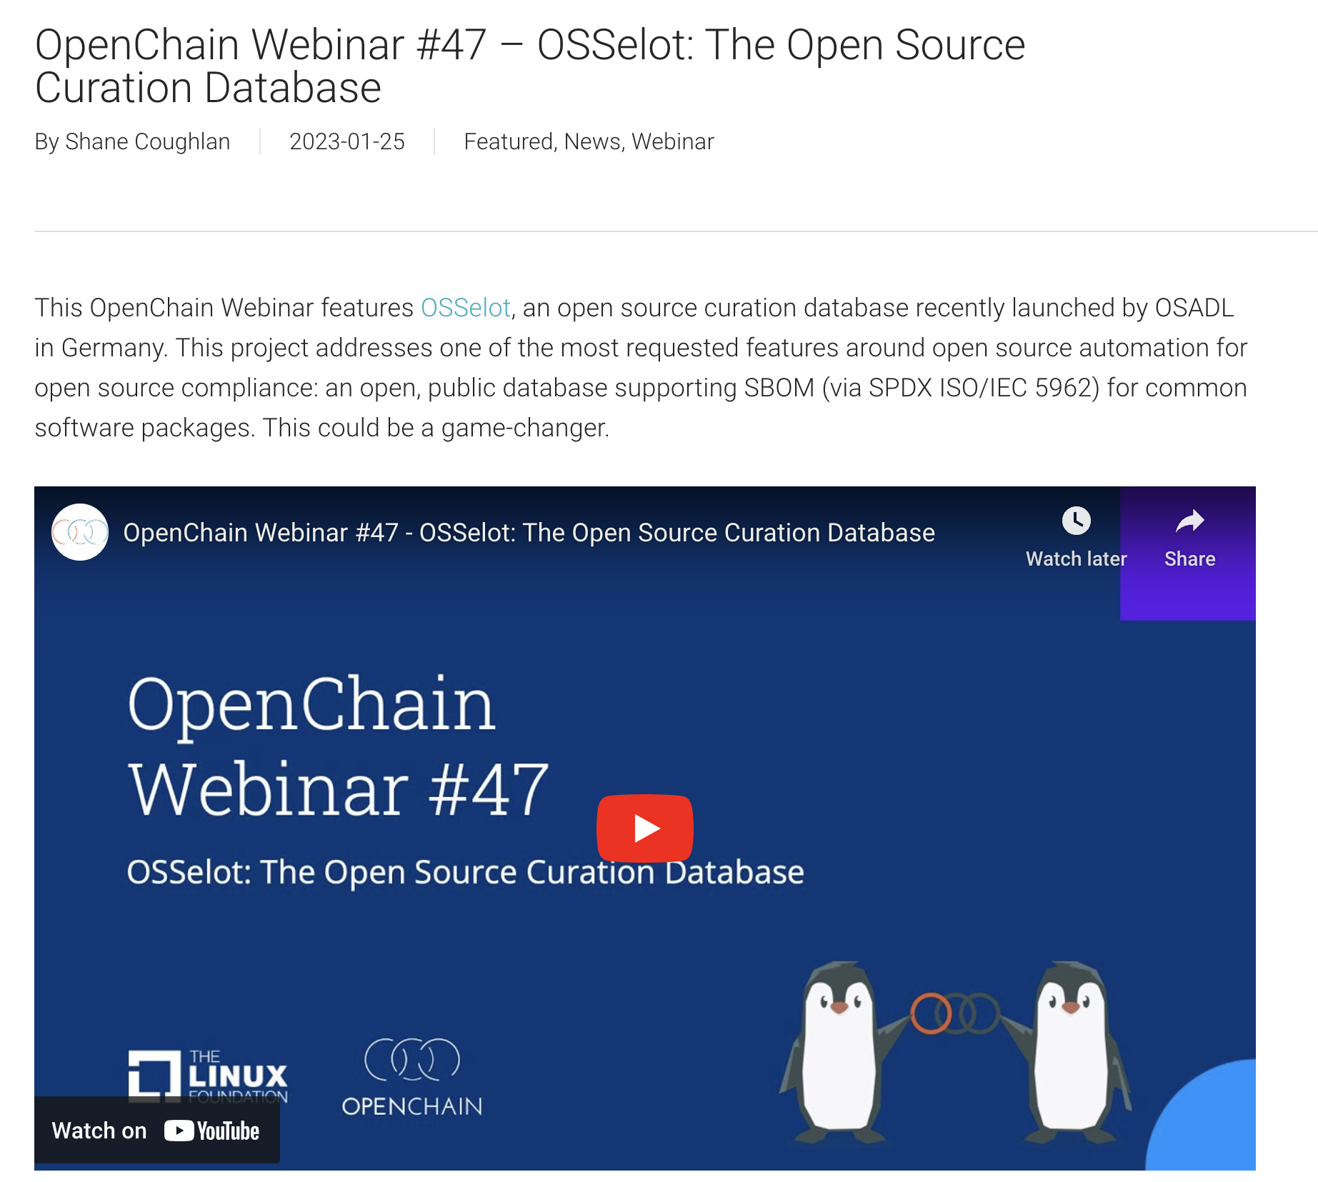
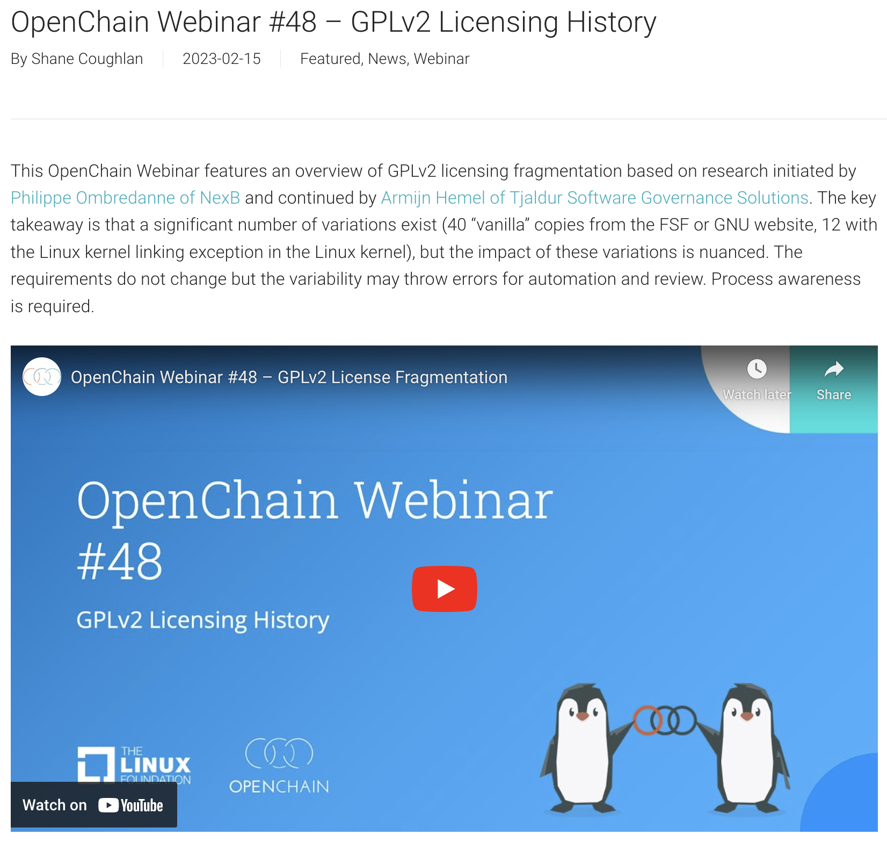
Continually Expanding Industry Knowledge

Slide 30
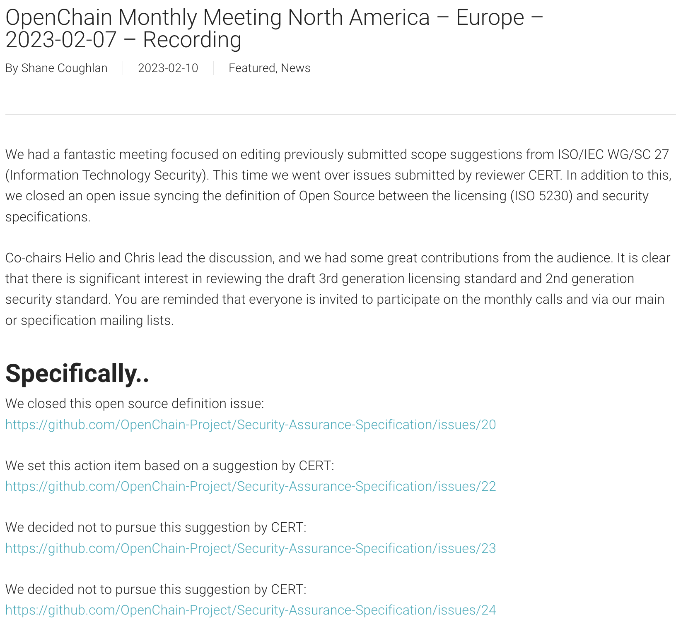

Actively Editing The Next Generation Standards

Slide 31

Be Part Of This
https://www.openchainproject.org/participate

